Slide 1



DATA ANALYTICS PROJECT
ZOMATO

Slide 2

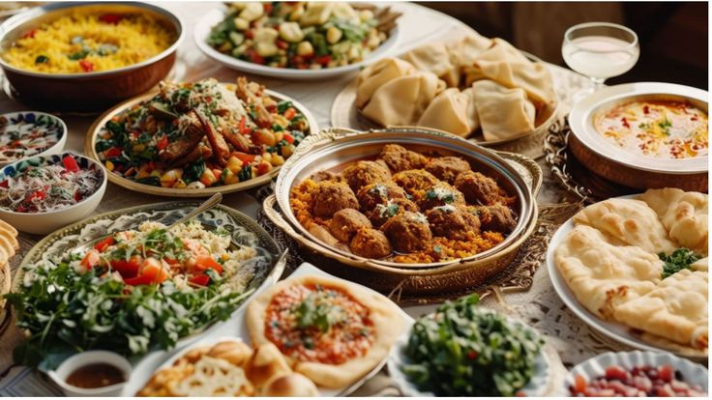
Page 2 of 15
Agenda
INTRODUCTION
DATA OVERVIEW
OBJECTIVES : KPIs
ANALYSIS
RECOMMENDATION AND INSIGHT CONCLUSION

Slide 3
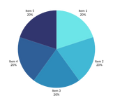



INTRODUCTION
Page 3 of 15
Welcome to the Zomato Data Analytics Project presentation, where we dive into analyzing key performance metrics for Zomato, one of the world’s leading online food delivery platforms.
This study utilizes the Zomato Restaurants Data, which comes from one of the most well-known platforms for discovering the best restaurants in a local area. Zomato allows users to search for restaurants based on various factors such as cuisine, average cost for two, reviews, ratings, and votes.
The dataset provides detailed information on numerous restaurant registered with Zomato from across the world. Key attributes in this dataset include votes, aggregate ratings, and average cost for two, which are valuable for users who frequently visit restaurants. This data can also in identifying preferred restaurants and submitting reviews for improvements.

Slide 4
Page 4 of 15
The ZOMATO Restaurant Dataset contains comprehensive information on various restaurants listed on Zomato across multiple cities worldwide. The dataset provides key attributes that can help analyze the restaurant’s popularity , customer preferences, and overall performances.
Key Features of the Dataset :
Restaurant Name : The name of the restaurant.
City/Location : Geographic location of the restaurant.
Cuisine : Types of cuisine served at restaurant (e.g. Italian, Chinese, Indian).
Average cost for two : Estimated average cost of dinning for two people, giving insights into the pricing strategy.
DATA OVERVIEW

Slide 5
Page 5 of 15
Aggregate Rating : A weighted average rating based on customer reviews.
Votes : The number of customer votes, indicating popularity or customer engagement
Reviews : Customer reviews and feedback on their dining experience.
Online Order Availability : Whether the restaurant offers online ordering options.
Table Booking Availability : Indicates if customers can book tables online.
Restaurant Type : Categories such as casual dining, quick bites, cafes, etc.
Country : Country where the restaurant is located.
DATA OVERVIEW

Slide 6
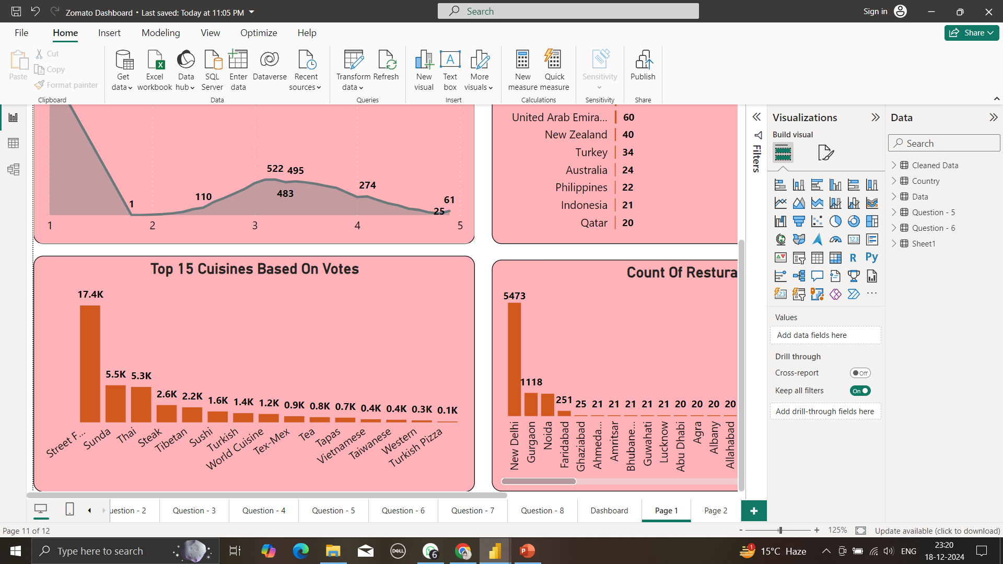

Top 15 Cuisines based on votes by Cities and Countries
Page 6 of 15
Key Insights :
Indian Dishes :
Indian Dishes are most popular in all over world

Slide 7
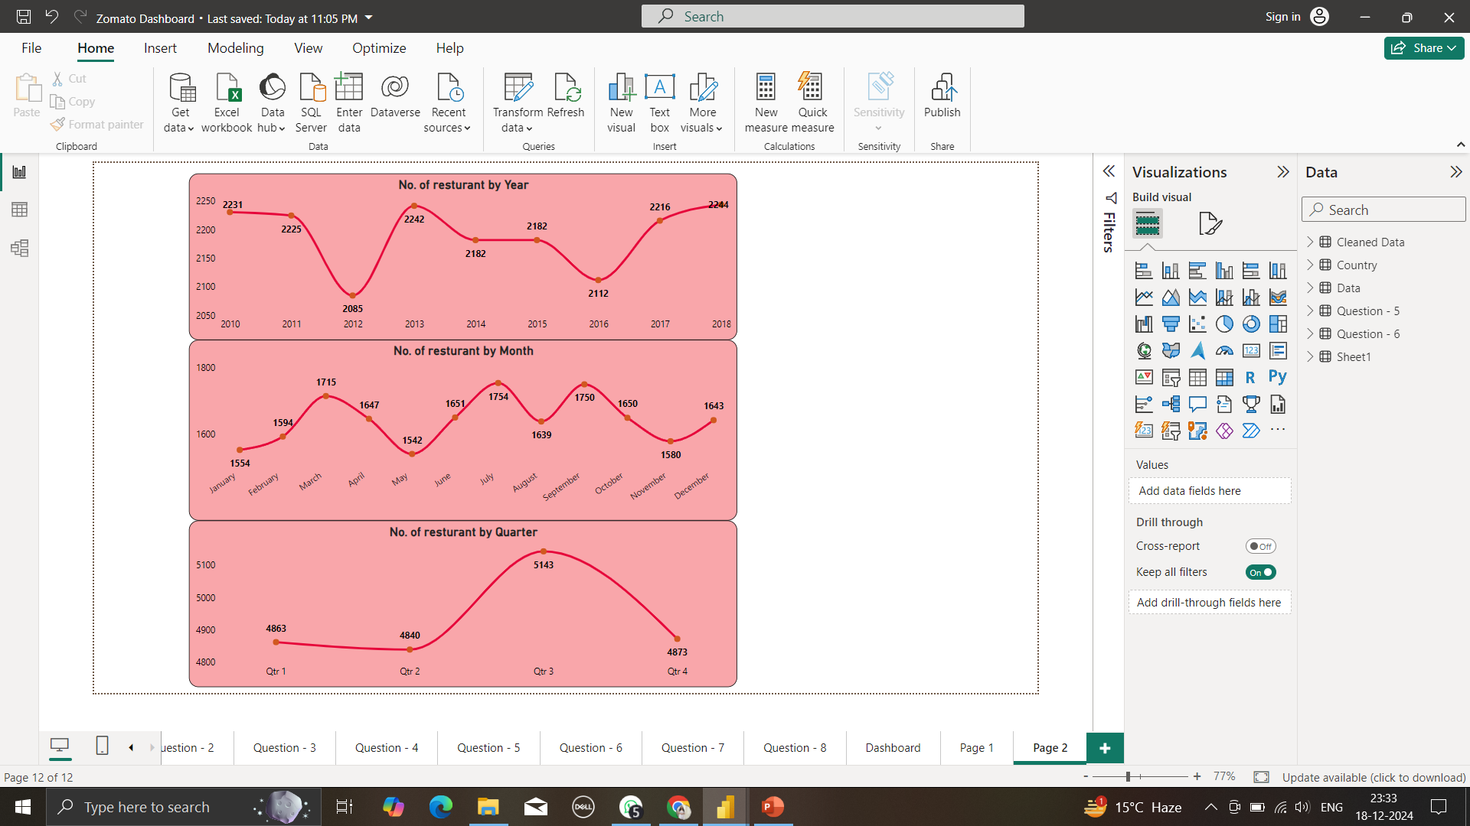
Number of Restaurants opening based on Year, Month, Quarters.
Page 7 of 15
ANALYSIS :
Even End of Q1, and Q3 has highest new restaurants opening.
The analysis of the 6.92% decrease in Total Restaurant between 2011 and 2012.
Key Insights :
Growth of Trend in Most Active Years :
The highest number of restaurant opening occurred in 2011 & 2018, with a total of 1098 & 1102 respectively new restaurants .
Raise in 2011 Zomato started its Operations in various cities like Hyderabad, Pune, Chennai, etc.. and also launched application for cellular devices.
Decline of Opening in restaurants Years :
Some years, such as 2012, 2015, 2016 saw fever restaurant openings, due to economic downturns, regulatory changes.
In 2012 Zomato has gone Globally and started acquiring restaurant listing companies in emerging markets.

Slide 8
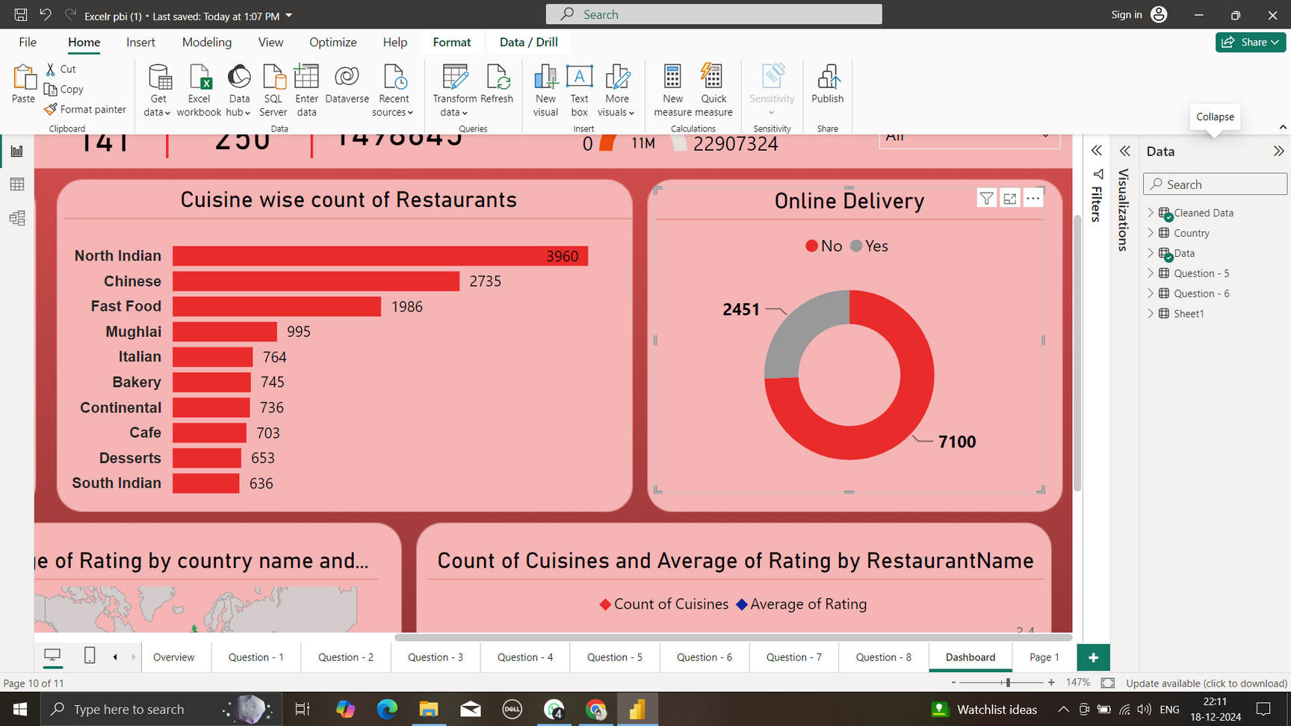
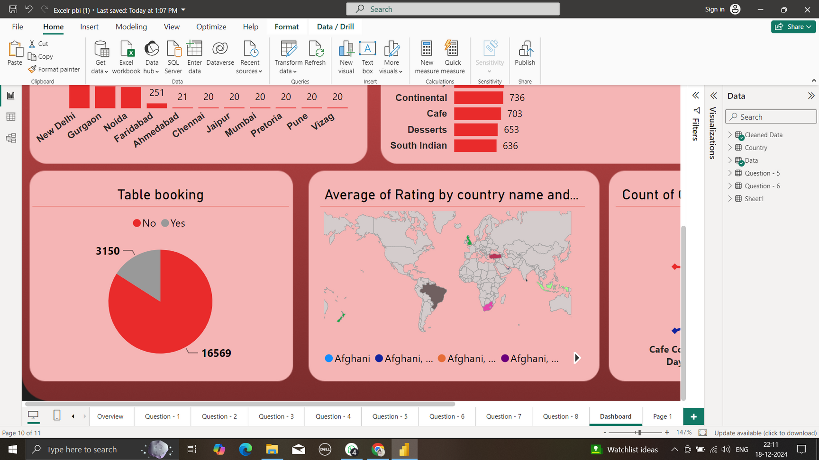
Percentage of restaurants based on “Has table booking” & “Has online delivery”
Page 8 of 15
Key Insights :
Has online delivery :
Total % Restaurants has No Online Delivery : 74.34%
Total % Restaurants has Online Delivery : 25.66%
Has Table Booking :
Total % Restaurants has No Table Booking : 87.88%
Total % Restaurants has Table Booking : 12.12%

Slide 9
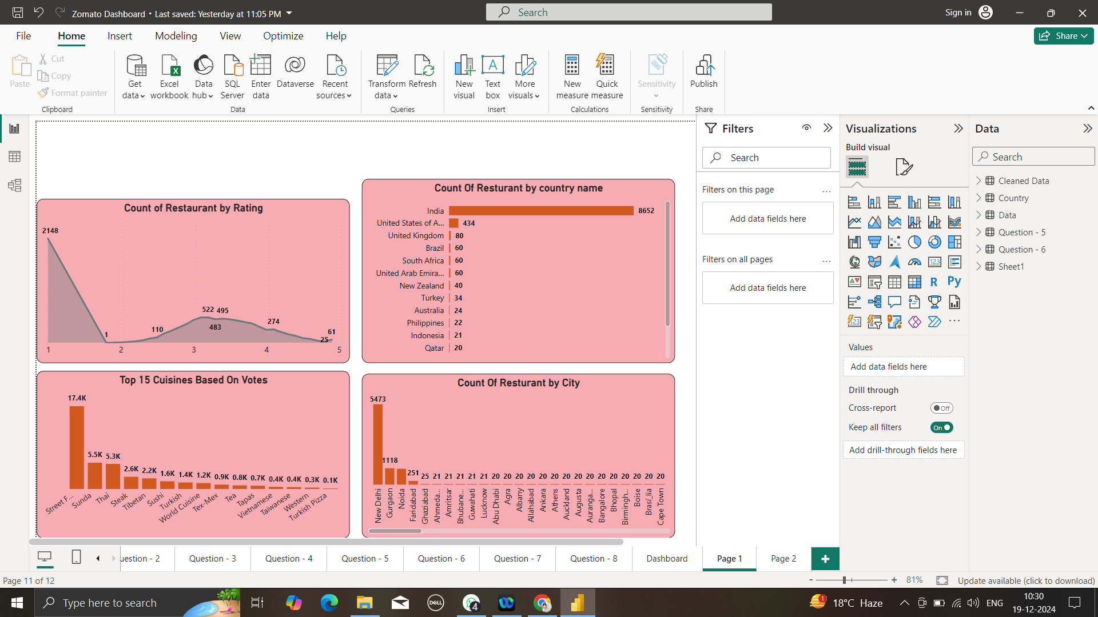
Number of Restaurants based on Country and City
Page 9 of 15
Analysis :
Zomato’s largest presence in India , when it has captured the majority of the restaurant market. This is followed by the United States and United Kingdom, where the platform has established itself as a reliable source for restaurant discovery and dining experiences.
Emerging markets like UAE and Australia show potential for growth, as evidenced by the number of listings, which which are steadily increasing.
Key Insights :
India
India represents the largest market for Zomato, with a significant of restaurants listed in major cities like New Delhi, Gurgaon, and Noida.
Total Restaurants :8652
United states :
The U.S is another major market with a large number of high-end and diverse.
Total Restaurants : 436

Slide 10
Count of Restaurant by Average Rating
Page 10 of 15
Analysis :
The Majority of restaurants fall into the well rated restaurant categories (2.0-3.0) reflecting generally positive customer experiences on Zomato .
A smaller percentage of restaurants are highly rated (4-5) suggesting only selective restaurant consistently exceed customer expectations.
Low-rated restaurants (below 3.5) represent areas where Zomato or the restaurant owners may focus on improvement initiatives to enhance customer satisfaction and reviews.
Key Insights :
Highly Rated Restaurants (4.0-5.0)
These Restaurants are typically top-tier establishments with exceptional service , food quality, and customer satisfaction.
Total count : 0.3K Restaurants .
Well- Rated Restaurants (2.0-3.0) :
The majority of restaurants fall within this rating range, indicating good overall performance and customer satisfaction.
Total Count : 3.7k Restaurants

Slide 11
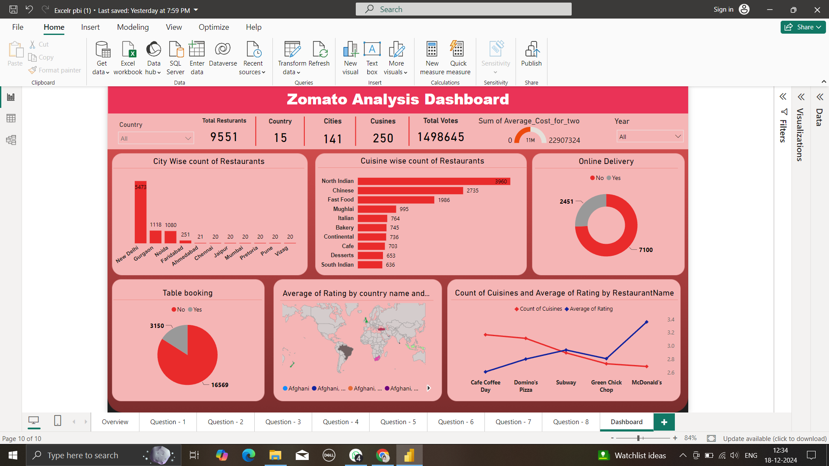
Page 11 of 15

Slide 12

CONCLUSION
Page 12 of 15
Conclusion Based on Findings
The analysis of Zomato’s restaurant data provides valuable insights into key performance indicators (KPIs0 such the number of restaurants by country, city, rating, pricing, and service offerings. These findings help illustrate several important trends and areas for improvement.
1.Global Expansion Opportunities : While certain countries and cities have a high concentration of restaurants, there are untapped regions with potenial for growth. By analyzing market saturation and customer demand, Zomato and restaurant owners can strategically expand into high-growth regions and understand areas.
2.Customer Preferences and Service Offerings : The data reveals the growing impotance of online delivery services as a primary driver of business for many restaurants. The convenience factor of online ordering, especially in urban areas, has shifted consumer behavior. Restaurants offering table booking cater to a niche of customer looking for an enhanced, in-restaurant experience, but the overall trend favors delivery for fast, casual dining.
3.Performance Based on Ratings : Higher- rated restaurants tend to benefits from more customer enagement and loyalty. This indicate the impotance of focusing on customer satisfaction, service, quality, and consistent food experience to drive up ratings and reviews, which, in turn, attract more customers.

Slide 13

Recommendations
Page 13 of 15
Number of restaurants by Country
Expand in High-Growth Countries
Target Local Preferences
Evaluate Competition
2. Count of Restaurants by Rating
Improve Customer Experience
Encourage Reviews
Monitor and Respond to reviews
3. Number of Restaurants by Opening year, Month, and Quarter
Focus on Seasonality Trends
Continues Innovation
Plan Operational Resources
4. Restaurant Bucket Analysis Based on Average Price
Diversity Pricing Strategy
Marketing Strategies Based on a Bucket
Bdjust Offerings by Region.

Slide 14


Page 14 of 15
Our Team Members
Mr. Shailesh BV
Mr. Sudhansu Moharana
Ms. Pooja Deshmukh
Ms. Rutuja Kalamkar
Mr. Rishikesh Gopal
Mr. Sreerag V S

Slide 15
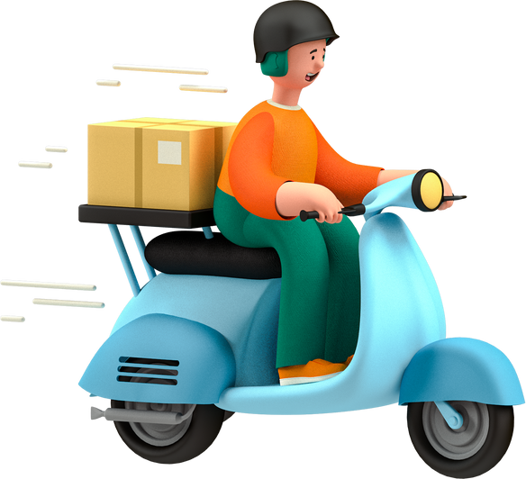
Thank you
for listening!
Got any questions? Feel free to ask us .

